Slide 1
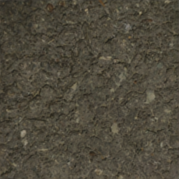
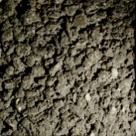
Output maps
Normal
Diffuse
Input
256 x 256 x 3
U-Net
256 x 256 x 9
...
...
Roughness
Specular
Discussion: Research and questions in neural methods for material acquisition
Valentin Deschaintre
Notes:
Good evening. I have been working on neural material acquisition during my Phd.
New methods for material acquisition with deep learning
Good time to take a step back and have a discussion about the limitations and what would be interesting to see next.
Quickly present the existing method for neural acquisition
Give some limitations I see and discuss everything together, I can also try to discuss the different methods in more details if you have questions there.
But a first question could be “why deep learning”?

Slide 2
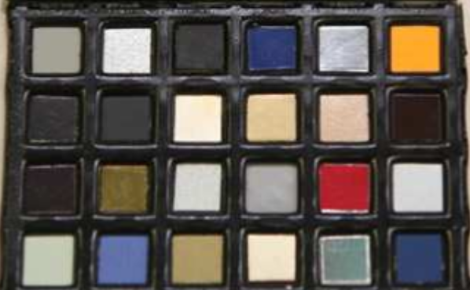
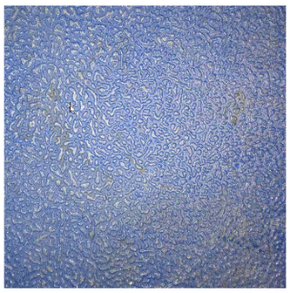
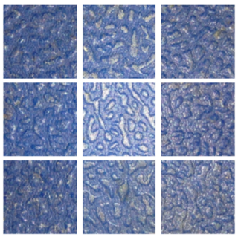
Why deep learning
“Pocket reflectometry”
Ren et al., 2011
“Reflectance Modeling by Neural Texture Synthesis”
Aittala et al., 2016
“Polarization imaging reflectometry in the wild“
Riviere et al., 2017
Matrix of known materials
Self repetitive materials
Natural light polarization
Notes:
Lightweight acquisition with a only few image is ill posed
Historically, assumptions were made about the materials or the lighting,
a few examples

Slide 3
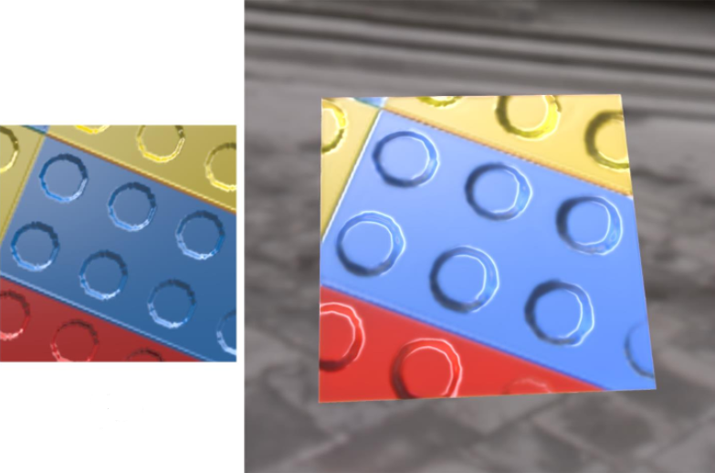
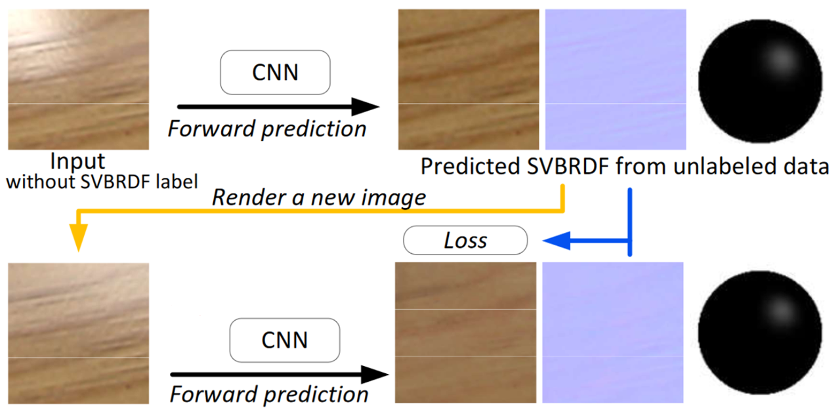
Data generation for material acquisition
Modeling surface appearance from a single photograph using self-augmented convolutional neural networks
Li et al., Siggraph 2017
Notes:
Li et al method propose in 2017 to use a CNN and an environmentaly lit image to infer a SVBRDF with a diffuse albedo, normal map and an approximate understanding of specularity.
But the main key of this paper was self augmentation to solve the absence of SVBRDF databases.

Slide 4
Data generation for material acquisition
Modeling surface appearance from a single photograph using self-augmented convolutional neural networks
Li et al., Siggraph 2017
Notes:
Explain self augmentation

Slide 5
Data generation for material acquisition
Modeling surface appearance from a single photograph using self-augmented convolutional neural networks
Li et al., Siggraph 2017
Notes:
Li et al method on acquisition, focused more on the lack of data

Slide 6
Data generation for material acquisition
Modeling surface appearance from a single photograph using self-augmented convolutional neural networks
Li et al., Siggraph 2017
Notes:
Li et al method on acquisition, focused more on the lack of data with self augmentation and allows to retrieve with one picture environment lit, normals, diffuse map and an approximate specular behaviour

Slide 7
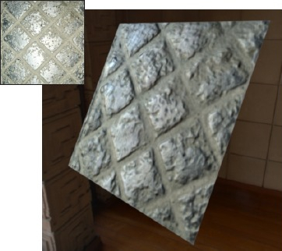
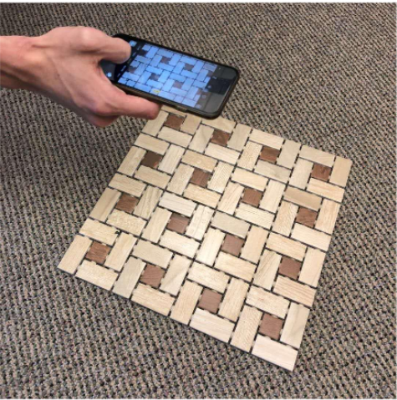
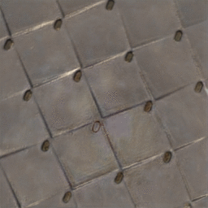
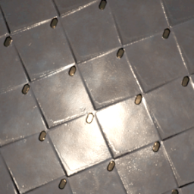
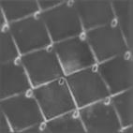
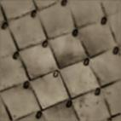
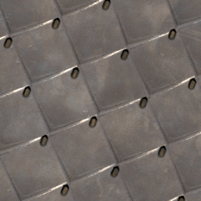
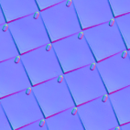
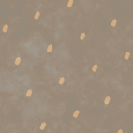
Synthetic training, flash and distance metric
Single-image svbrdf capture with a rendering-aware deep network
Deschaintre et al., Siggraph 2018
Materials for Masses: SVBRDF Acquisition with a Single Mobile Phone Image
Li et al, ECCV 2018
Input
Inferred maps
Differentiable Renderer
CNN
-
Ground truth
Differentiable Renderer
Notes:
Last year 2 (concurrent) methods were proposed using Flash input to get a better sense of the material behaviour, increasing quality
This time the problem of data is solved through procedurally generated training data,
Finally we use a different distance metric for the optimization function.
Explain the rendering loss
So far all the methods I talked about work on near planar surfaces.

Slide 8
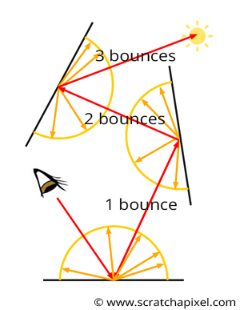
Going to 3D
Learning to Reconstruct Shape and Spatially-Varying Reflectance from a Single Image
Li et al., 2018
Simulation of multiple lighting bounces
Notes:
So, at the end of last year a new method was introduced to somewhat handle 3D objects.
The main challenge here is the differentiation of the rendering process with shapes for the optimization.
They solve it using a cnn to basically simulate the rendering process, taking bounces of light into account

Slide 9
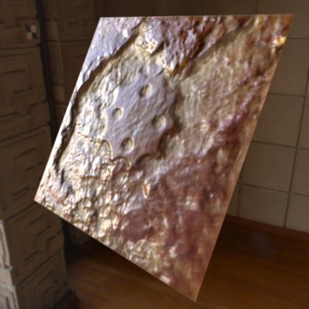
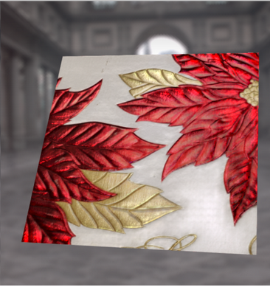
Multiple images and higher resolution
Flexible SVBRDF Capture with a Multi-Image Deep Network
Deschaintre et al., EGSR 2019
Deep Inverse Rendering for High-resolution SVBRDF Estimation from an Arbitrary Number of Images
Gao et al, Siggraph 2019
Notes:
All previous method get an image but if you don’t like the result: meh.
Multiple image to improve the result.
and higher resolution and classical optim in an untangled dimension for Gao

Slide 10
Summary and future work
What we have:
Neural material acquisition
Rendering loss
3D objects
Multiple image aggregation
What’s next?
Meaningful metric (Lagunas et al. 19, Gao et al. 19)
Differentiable rendering (Azinović et al. 19)
Scale (Mazlov et al. 19)
Real data (Merzbach et al. 19)
Uncalibrated results
What do you think ?
Notes:
So we have all these properties.
What I think is more interesting to discuss are the limitations and the next steps to take that would be interesting to the community. Here are a few I found interesting and first steps in solving them.
Describe them
So now the question is what do you think ? What limitation would you like to see fixed, or what could be adapted from your different fields to solve these challenges.

